Slide 1
GIPF Game
Dionysis Tsougkaris Dingding Martin Marc Lindner Frans Manders Leroy Kroon

Slide 2
Outline
Introduction
GIPF Game
Problem Statement
Demo
Research
Decision Trees
Minimax
Evaluation Function
Monte Carlo

Slide 3
Introduction

Slide 4
Problem Statement
Create a 2 player Board Game
Human-Human

Slide 5
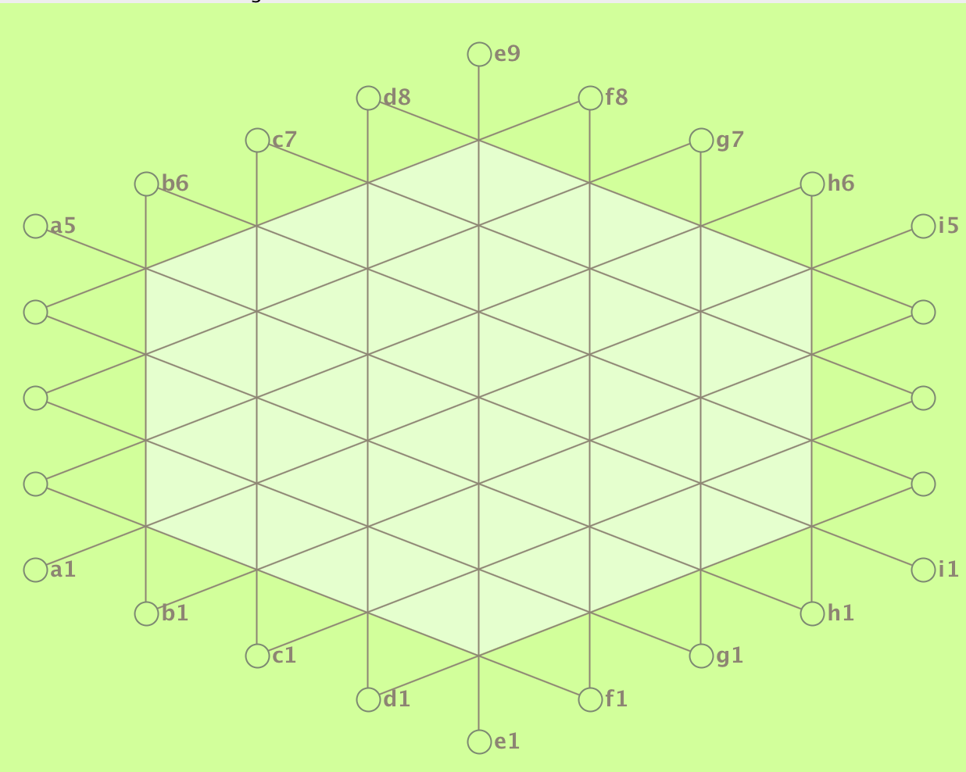
Gipf Game
Board
Tri Gridded
Hexagonal
Minimum degree of vertices = 1
Maximum degree of vertices = 6
24 Outer Spots (dots)
37 positions in play area

Slide 6
The general idea:
Setup for each player:
3 pieces on fixed positions in playing area
12 pieces left in reserve
Taking turns:
White begins
Place a piece on the outer dots, and move it towards the playing area
If 4 pieces of the same color form a line, remove all adjacent pieces on that line
Winner:
If a player has no pieces left, the other player wins
From http://www.gipf.com/gipf/rules/complete_rules.html

Slide 7
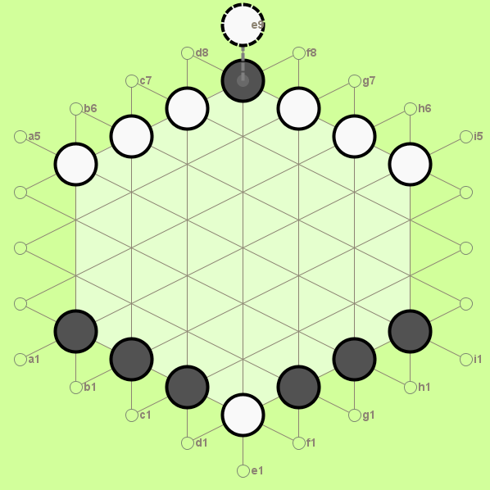
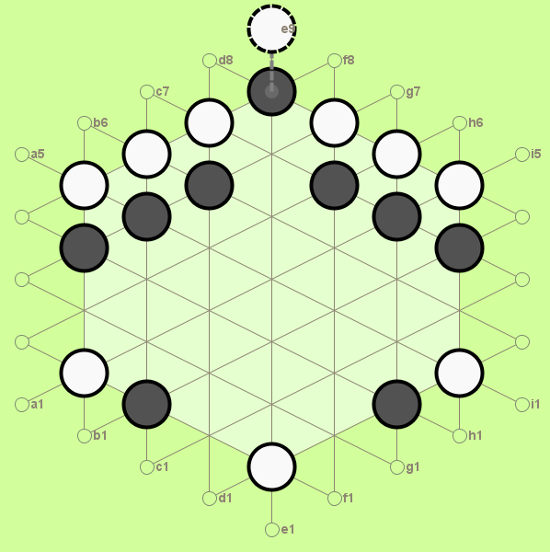
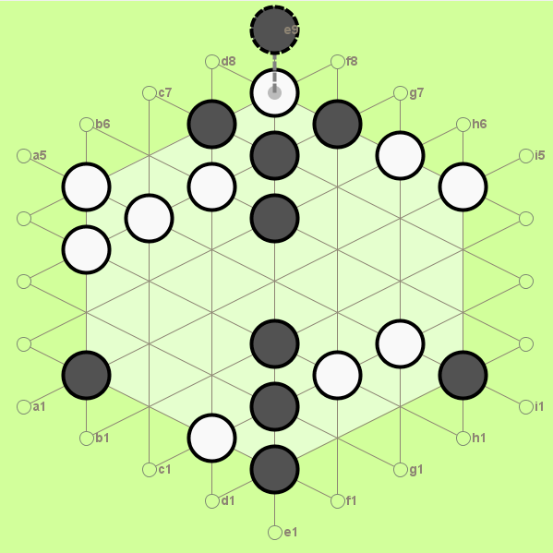
Removing lines
Current player removes lines first
If same-color lines intersect, the current player must choose

Slide 8
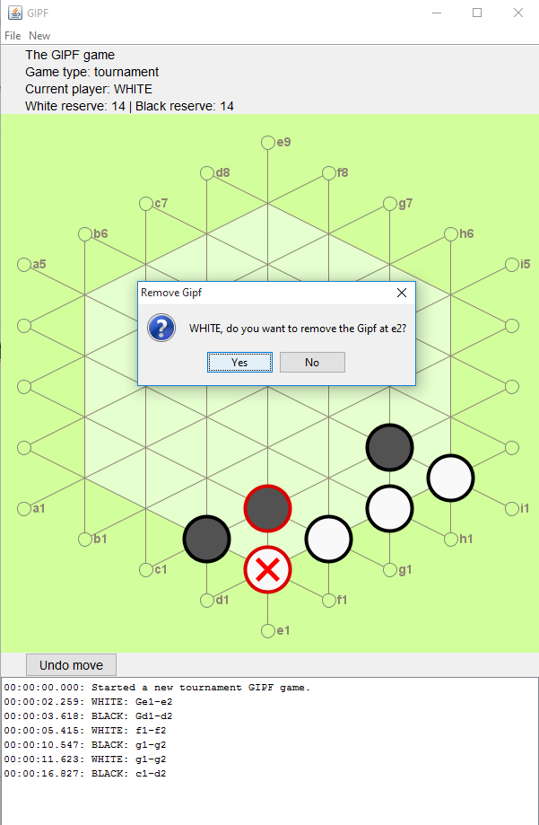
Gipf pieces
The standard and tournament type games include Gipf pieces
Count as 2 normal pieces
If the current player removes lines, he can choose whether to remove each Gipf piece
Even when its a piece of the opponent
If the last Gipf piece of a player is returned, the player loses

Slide 9
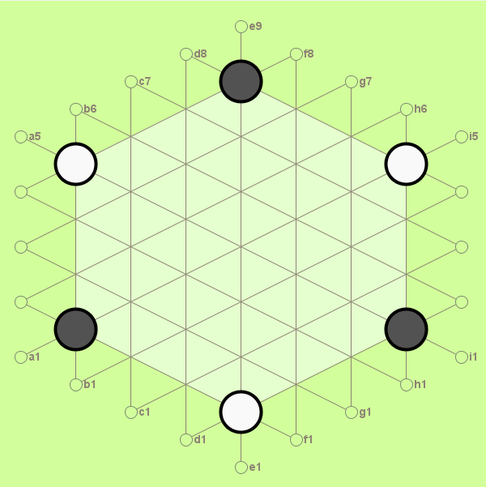
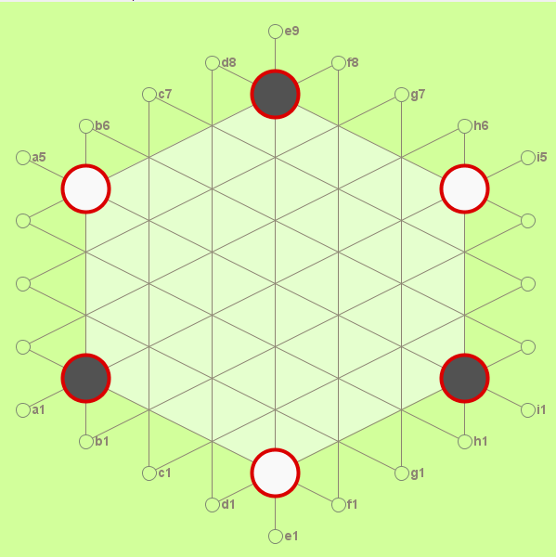
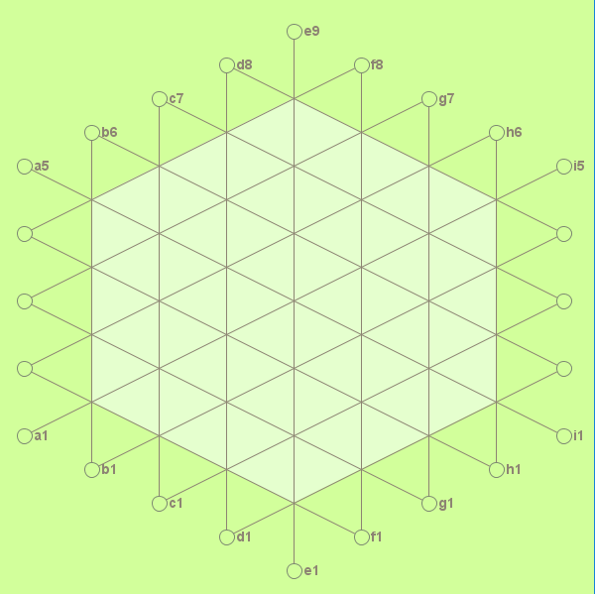
Game types
Basic
Reserve: 12
Players start with 3 pieces on the board
No Gipf pieces
Standard
Reserve: 12
Players start with 3 Gipf pieces on the board
Player can’t introduce new Gipf pieces
Tournament
Reserve: 18
Start with empty board
Player can place Gipf pieces until he has placed normal pieces
Must start with Gipf

Slide 10
Demo

Slide 11
Research

Slide 12
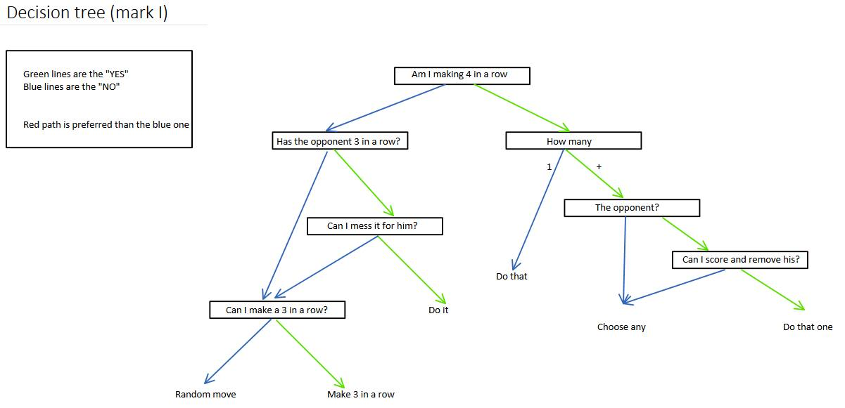
Decision Trees

Slide 13
Minimax
Minimax
Goes through all possible game trees Depth First
Assumes that the opponent Player will always try to minimize the other players score and maximize his own
If
(Can win in next move)
Do
(Other play can win in next move)
Block
Works on the basis of a utility function

Slide 14
Evaluation Function
The performance of most algorithms will come down to the implementation of the evaluation function
Every constellation must have a certain score
The other user must know where the most “danger” or the maximum score for the opponent player lies and also what for him is the best situation
Linear evaluation function determines the value of each piece at any given time to calculate what the value is of a player
Breadth First vs Depth First

Slide 15
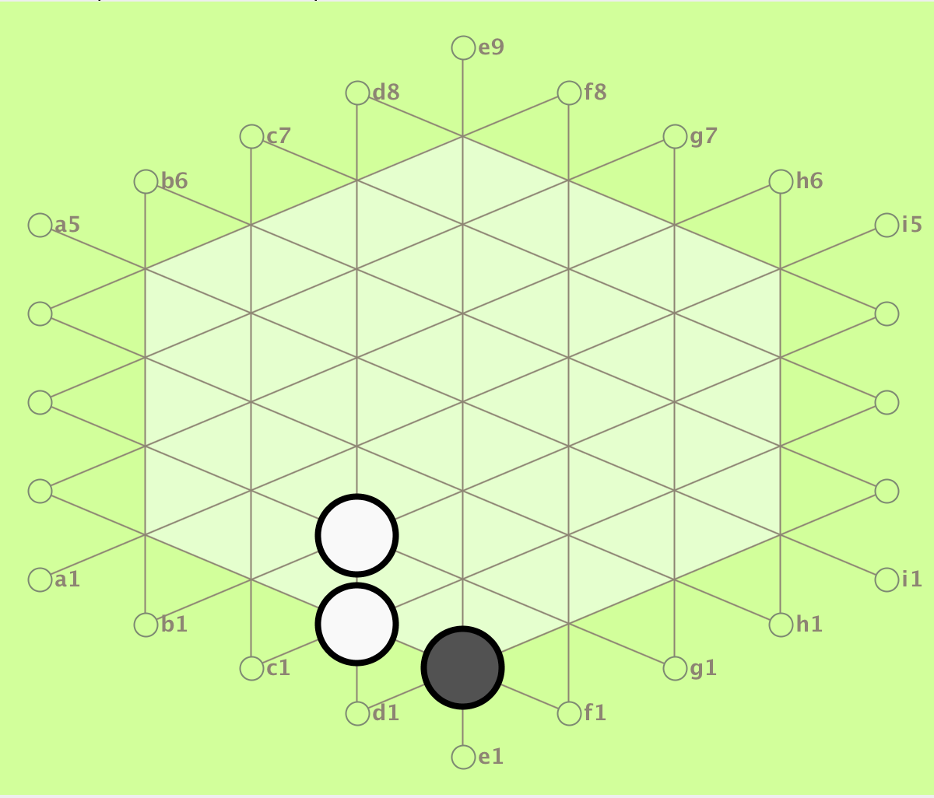
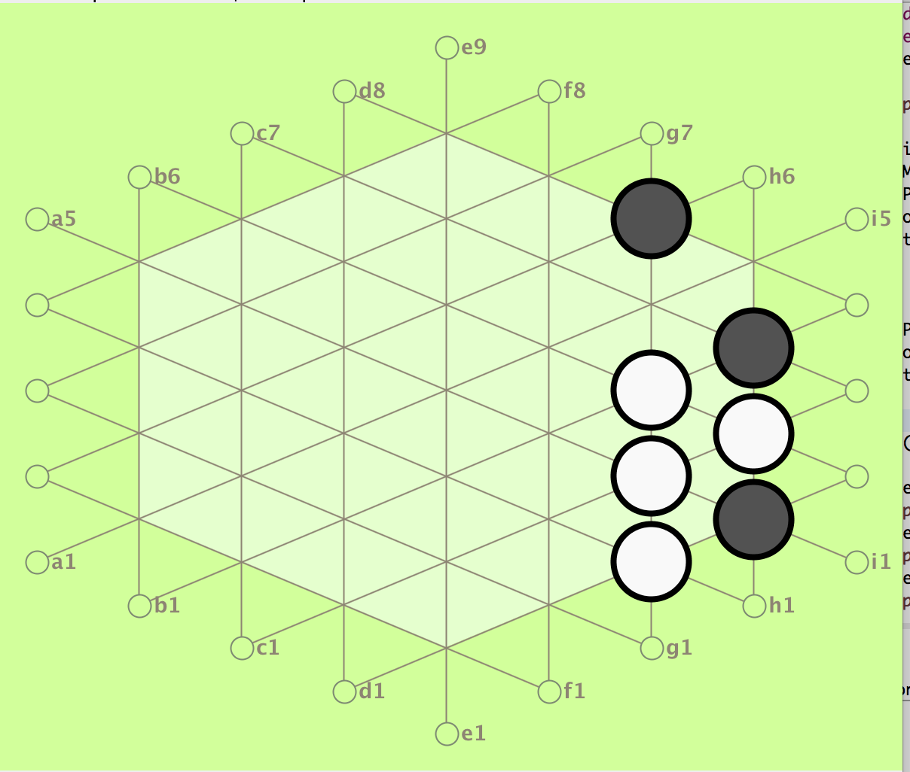
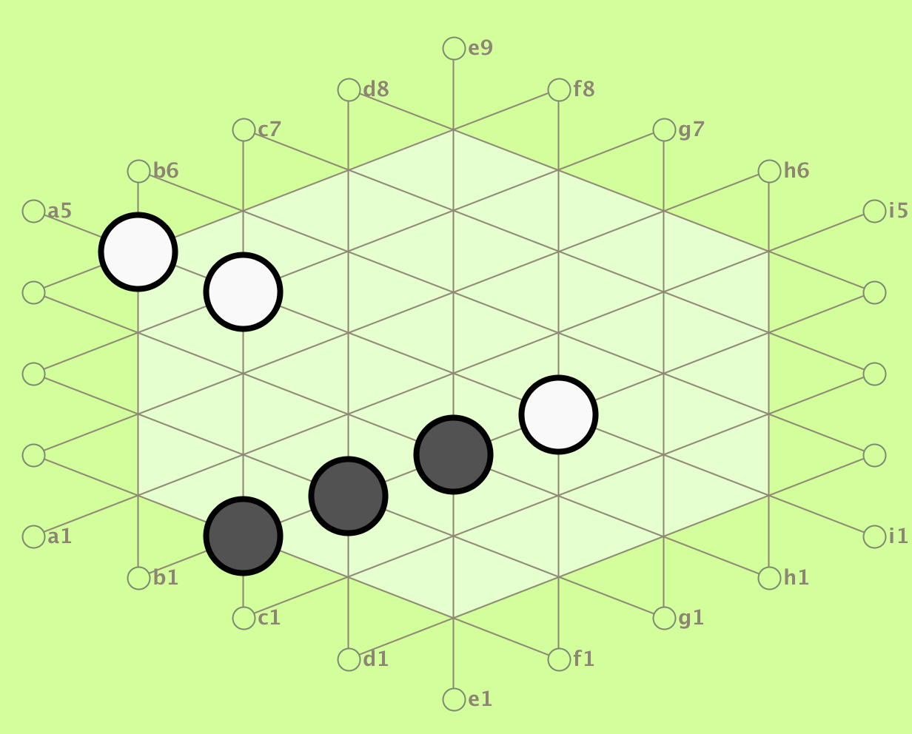
Evaluation Function
Low Value
Medium Value
High Value

Slide 16
Evaluation function: Variables
RAVE(statistics of winning history)
Last good reply
Value influenced by
Number of pieces on board
Number of pieces in reserve
Gipf pieces opponent can be taken
Losing Gipf pieces
Losing

Slide 17
Monte Carlo
Already used for Go, most complex game for AI
Consists of 4 steps
Selection Starting from root select child L
Expansion If not game over, choose child of L called C
Simulation Play random playout from C
Backpropagation Update all nodes on path C to R
Selection = random
Can be improved by using evaluation function

Slide 18
Planning
Activity | Week
 | 44 | 45 | 46 | 47 | 48 | 49 | 50 | 51 | 52 | 53 | 1 | 2 | 3
 |  |  |  |  |  |  | PSP | Exams | Holiday | Holiday |  |  | PFP
Implement Game Tree Data Structure (cont.) | x
Implement Evaluation functions | x | x
Implement Minimax |  | x | x
Implement Alpha-Beta |  |  | x | x
Implement Decision tree |  | x | x
Implement MCTS |  |  | x | x
Research Opponent Modelling | x | x
Compare Evaluation functions |  |  | x | x |  |  |  |  |  |  | x | x
Compare Algorithms |  |  |  | x | x |  |  |  |  |  | x | x
Create presentation |  |  |  |  |  | x |  |  |  |  |  | x
Write report |  |  |  |  |  | x |  |  |  |  | x | x
 |  |  | First AI's

